Slide 1


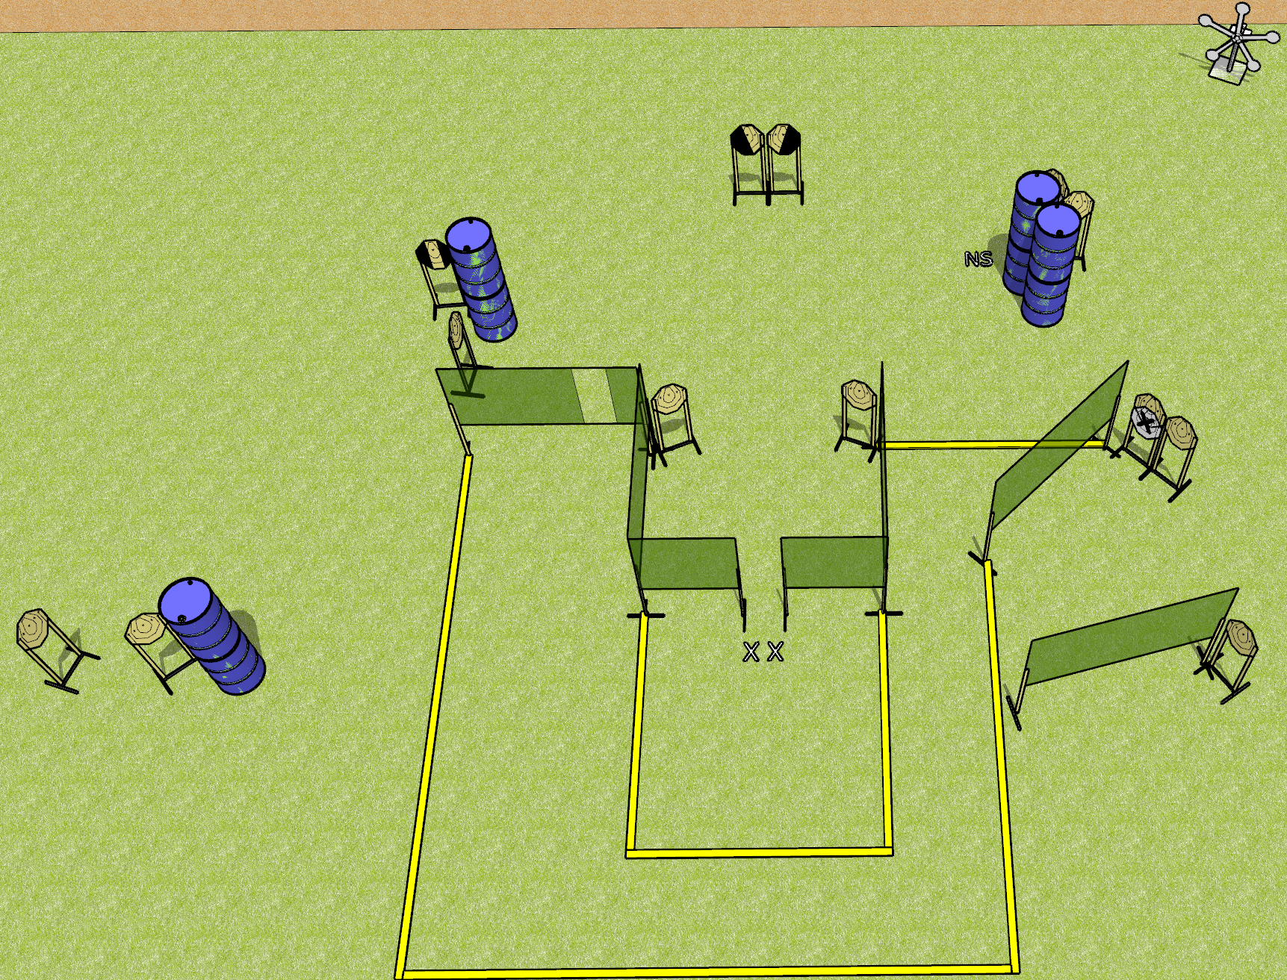
 | Dothan Gun Club – USPSA Match You Can’t Make This Up Course Designer : Drew Coleman
Round Count 29 rounds 12 IPSC targets 5 falling plates
Equipment List 11 wall feet Texas star 1 tux, 1 left and 1 right diagonal NOTE: target behind barrels on the right has a NS on it

Slide 2
You Can’t Make This Up
Written Stage Briefing
You Can’t Make This Up is a 29 round, 145 point, Comstock field course. There are 12 IPSC targets and 5 falling plates. The best 2 hits on paper will score and steel must fall to score. The start signal is audible.
Handgun start position is both feet on X’s, hands touching both walls. Handgun is loaded and holstered.
PCC start position is both feet on X’s, muzzle touching either wall. Carbine is loaded, safety on.
On start signal, engage targets as they become available from within the shooting area.

